Slide 1


Non-Local Equilibrium vs Noise: Direct Simulation Monte Carlo of Rarefied Gases
David A. Aji and S. Kokou Dadzie
School of Engineering and Physical Sciences, Heriot-Watt University, Edinburgh, EH14 4AS Scotland, UK
Journal: Frontiers in Mechanical Engineering, may be published (2026)

Slide 2
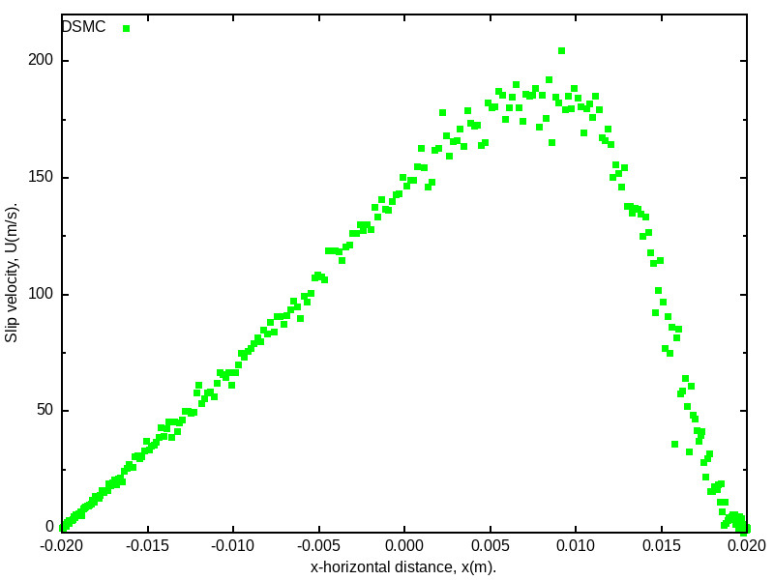
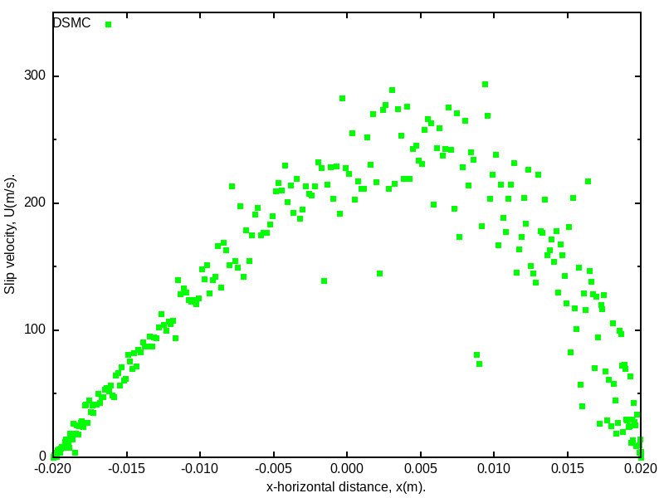
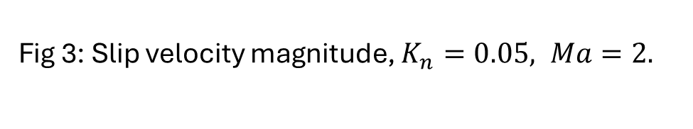
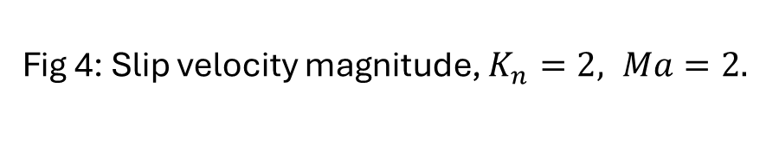
‘Noise’ in DSMC
Fig 3: Slip velocity magnitude, $K_{n}=0.05, Ma=2.$
Fig 4: Slip velocity magnitude, $K_{n}=2, Ma=2.$
Rarefied gas DSMC noise increases as the flow's Knudsen number rises. Are these normal statistical noises?

Slide 3
‘Noise’ in DSMC: Existing attempts in the literature
Kumar et al. Journal of Spacecraft and Rockets (2018), applied a post-processing technique based on POD to denoise DSMC data.
Variables such as velocity, pressure, temperature, and Mach number were compared before and after post- processing, and the algorithm achieved converged, low- scatter results in less computation time.
M. Sadr and N. G. Hadjiconstantinou, A variance-reduced direct monte carlo simulation, Journal of Computational Physics 472, 111677 (2023)
This is a stronger modification to the DSMC method itself.

Slide 4
‘Noise’ in DSMC: Existing attempts in the literature
Fig 7: Kumar et al., Journal of Spacecraft and Rockets, 55(4) 841-847 (2018).

Slide 5
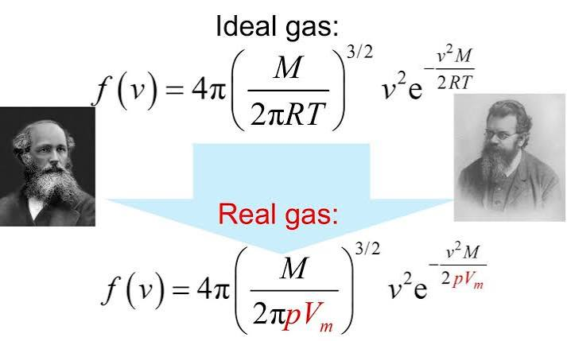
‘Noise’ in DSMC: Standard statistical mechanics vs non-local equilibrium
Local Boltzmann-Maxwellian distribution:
Defines local thermodynamic properties: T(x) and p(x);
( Vm(x) )
Fractional error in temperature:
Transport coefficients:
It appears that these errors in standard statistical mechanics directly define transport coefficients: viscosity and the heat conduction coefficient.
Rarefied gas DSMC noise increasing with Knudsen number rises are non-local equilibrium effect related

Slide 6
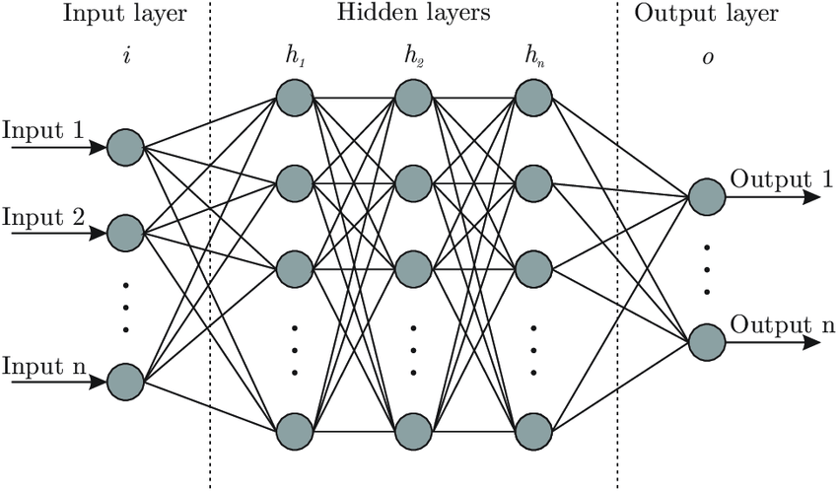
Present Methodology
ANN - consists majorly of three layers (input, hidden, and output). The hidden layer houses the major computations.
Several parameters, such as the learning rate, the number of neurons, the activation function, and so on, that need to be considered when training the model to achieve the desired outcome (output).
This training is done with low Knudsen number simulations which is then used to predict high Knudsen number profiles.
Fig 9: Simple ANN structure

Slide 7
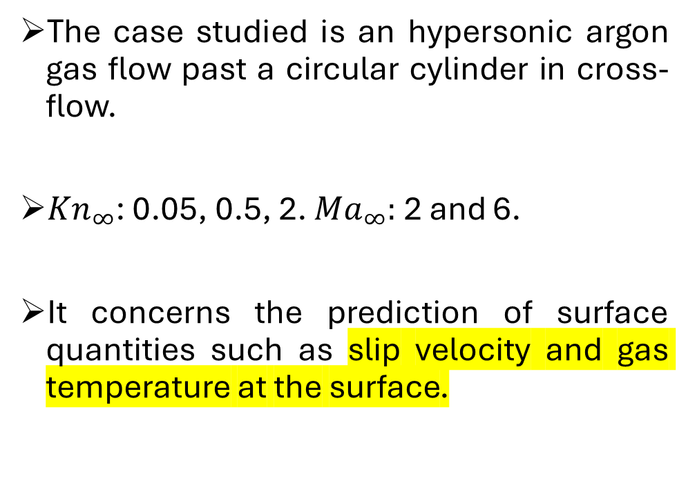
Present Methodology
Fig 10: Geometry of the case studied.
The case studied is an hypersonic argon gas flow past a circular cylinder in cross-flow.
${Kn}_{∞}$: 0.05, 0.5, 2. ${Ma}_{∞}:$ 2 and 6.
It concerns the prediction of surface quantities such as slip velocity and gas temperature at the surface.

Slide 8
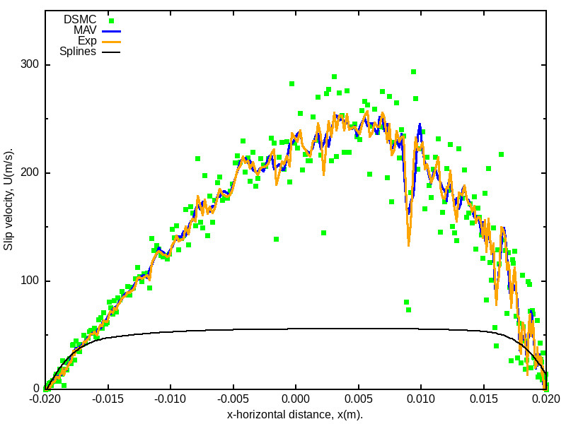
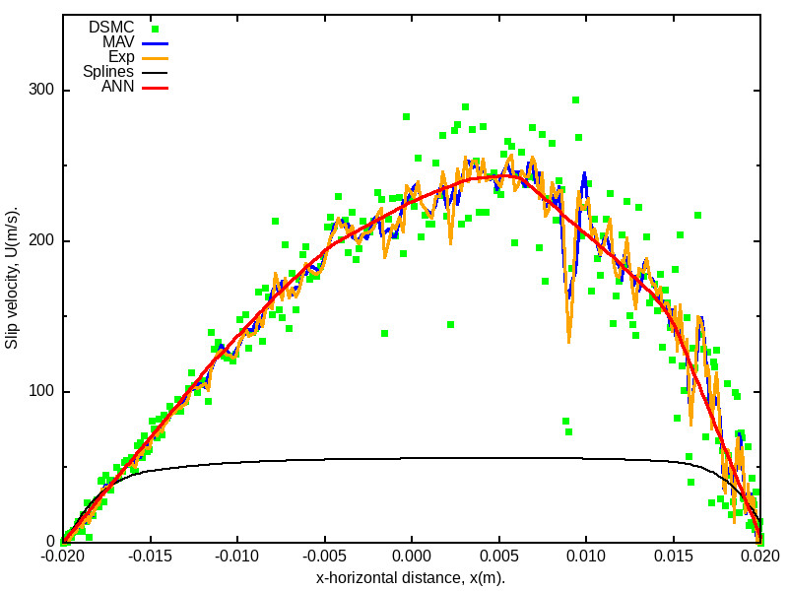
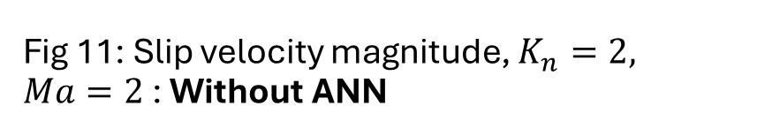
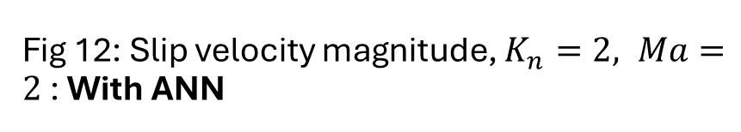
Results: Non-local equilibrium vs noise
Fig 11: Slip velocity magnitude, $K_{n}=2, Ma=2$ : Without ANN
Fig 12: Slip velocity magnitude, $K_{n}=2, Ma=2$ : With ANN
ANN (Machine Learning) extracts actual physical profiles. It is different from standard regression methods

Slide 9
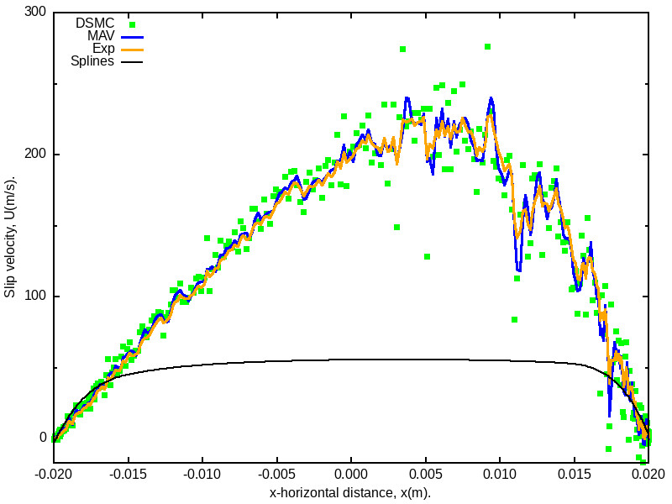
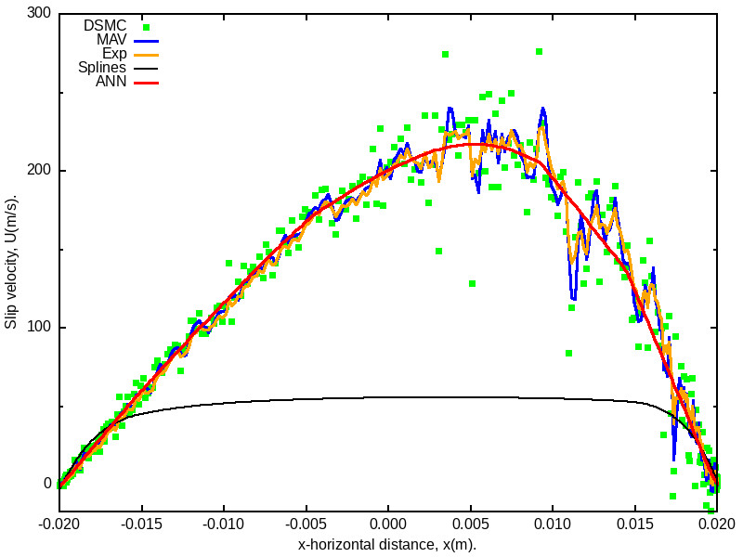
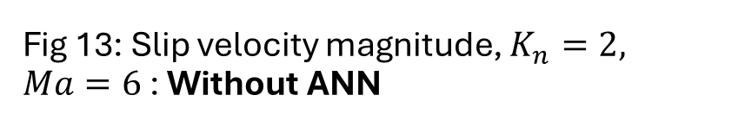
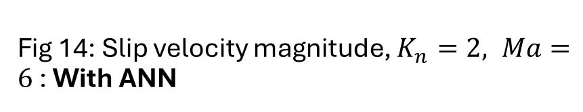
Results: Non-local equilibrium vs noise
Fig 13: Slip velocity magnitude, $K_{n}=2, Ma=6$ : Without ANN
Fig 14: Slip velocity magnitude, $K_{n}=2, Ma=6$ : With ANN
ANN (Machine Learning) extracts actual physical profiles. It is different from standard regression methods

Slide 10
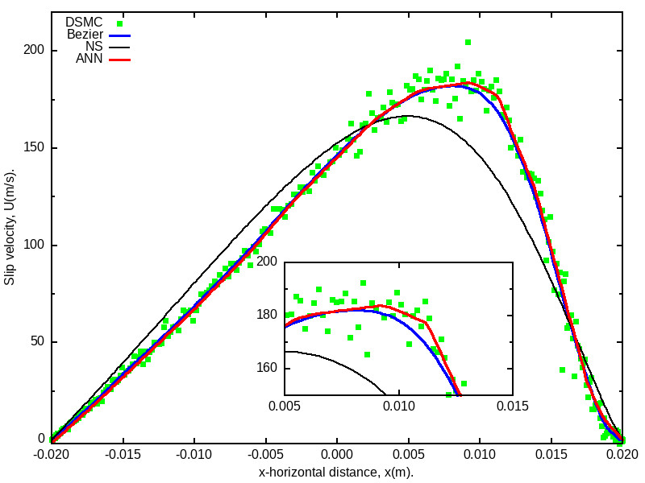
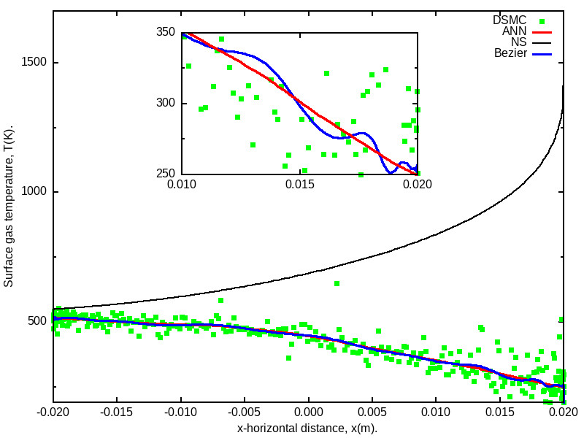
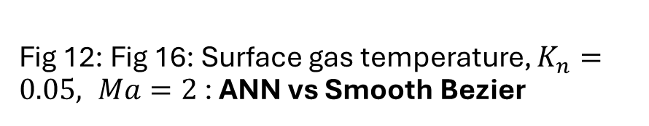
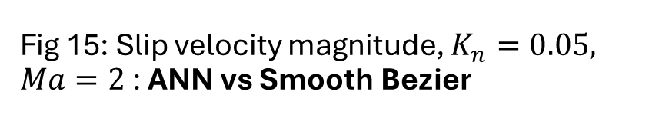
Results: Non-local equilibrium vs noise
Fig 15: Slip velocity magnitude, $K_{n}=0.05, Ma=2$ : ANN vs Smooth Bezier
Fig 12: Fig 16: Surface gas temperature, $K_{n}=0.05, Ma=2$ : ANN vs Smooth Bezier
ANN (Machine Learning) extracts actual physical profiles. It is different from a mere data fitting

Slide 11
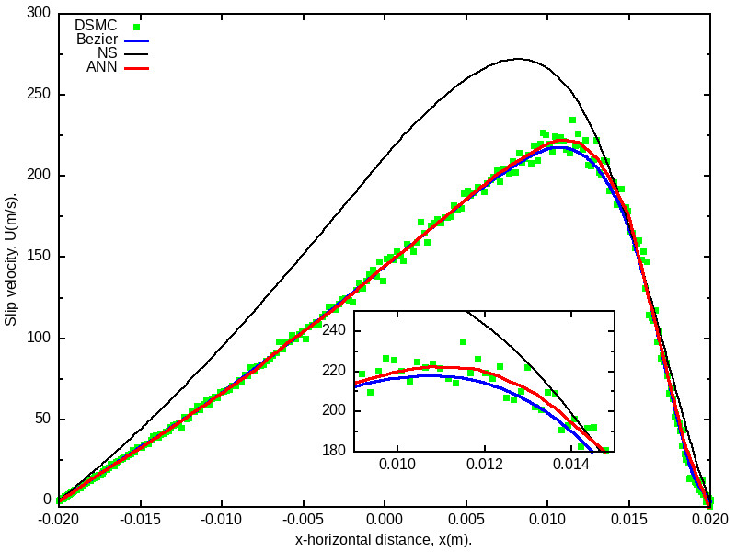
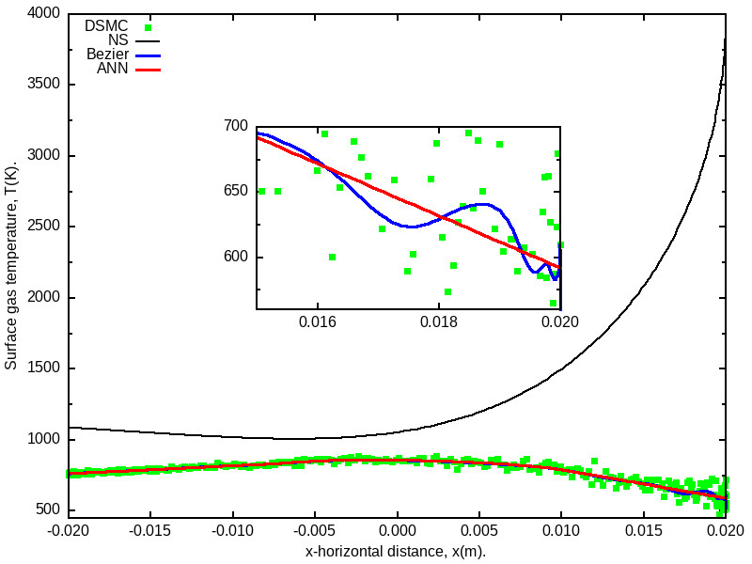
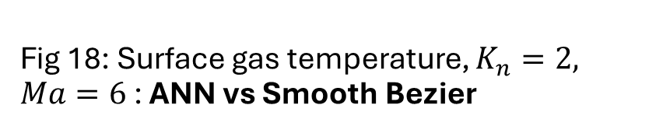
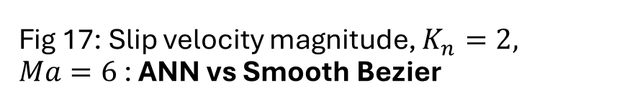
Results: Non-local equilibrium vs noise
Fig 17: Slip velocity magnitude, $K_{n}=2, Ma=6$ : ANN vs Smooth Bezier
Fig 18: Surface gas temperature, $K_{n}=2, Ma=6$ : ANN vs Smooth Bezier
ANN (Machine Learning) extracts actual physical profiles. It is different from a mere data fitting

Slide 12
Conclusion
Noise in Direct Simulation Monte Carlo (DSMC) data is correlated with non-local equilibrium in rarefied gas flows.
We developed an ANN (artificial neural network) algorithm to cope with this noise.
ANNs may offer appropriate tools to profile high Knudsen number flows at low costs. Not just fitting the data!

